Slide 1


DevOps Gap-Development

Slide 2




Prerequisite
Use Workshop-VM / Workshop-Computer follow the instructions of the Boarding Pass
Visual Studio Code
https://code.visualstudio.com
Git
https://git-scm.com
Competence Team DevTech
Microsoft AL

Slide 3
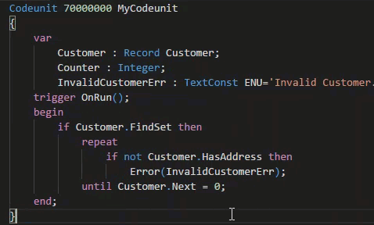
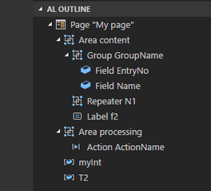
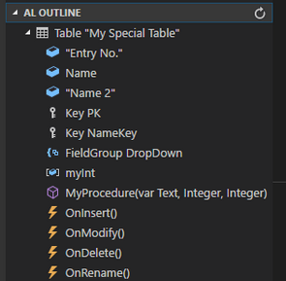
VS Code Useful Extensions
AL Formatter
Indentation
Keyword case style
Sort variable definitions
Readability Guidelines - Spacing and newlines (experimental)
AL Code Outline
Outlining – AL Object Structure
“Create List Page” from Table
“Create Card Page” from Table
al-util
“Rename & Move” Objects
Templates e.g. “Readme.md”

Slide 4


1
Introduction Git
2
Project Start
AGENDA
3
BERATUNGSPHILOSOPHIE
4
WARUM MICROSOFT?
5
WARUM COSMO CONSULT?
6
KUNDEN VON COSMO CONSULT
7
COSMO CONSULT INTERNATIONAL / GLOBAL SERVICE

Slide 5
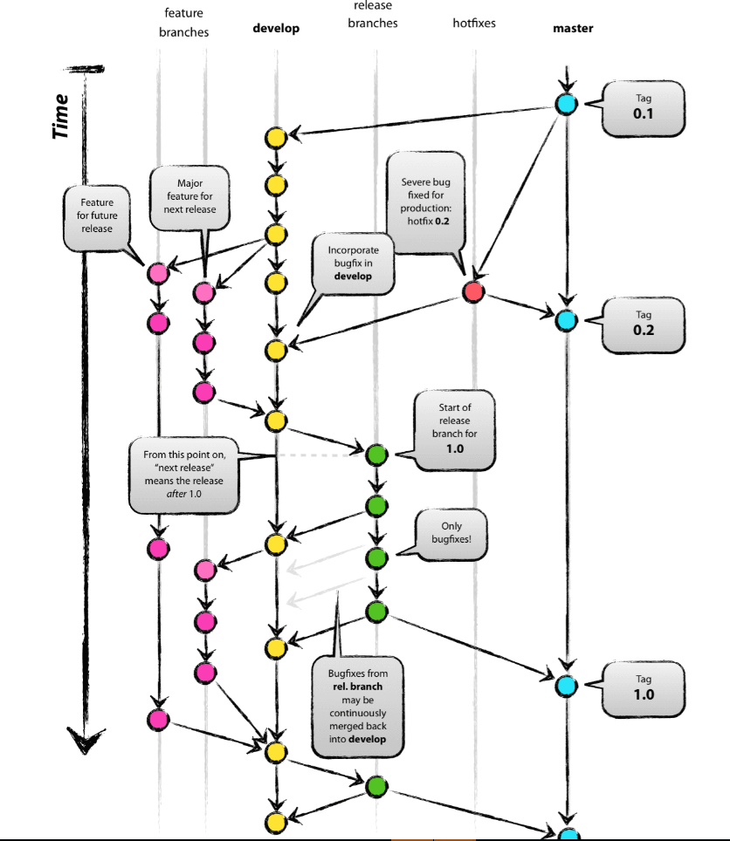
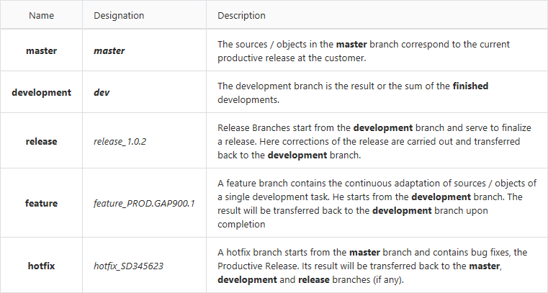
Gap-Development Process [Repo]
Organization in Branches 1 GAP → 1 Feature Branch

Slide 6

Git
Commands, Branch, Hands-On
6

Slide 7

Q & A
Competence Team DevTech
Channel Microsoft AL

